Slide 1

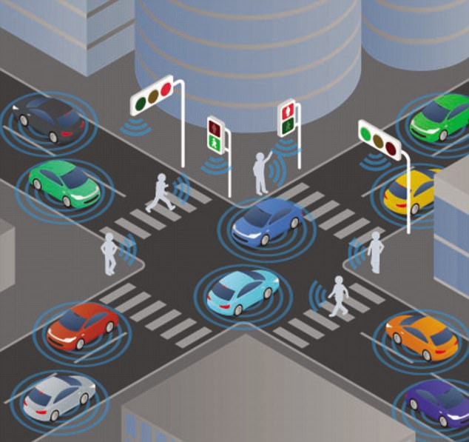
Smart Traffic Light
Authors:
Nayib Ega
Manuel Mane
May 17, 2019

Slide 2
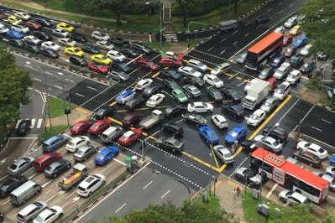
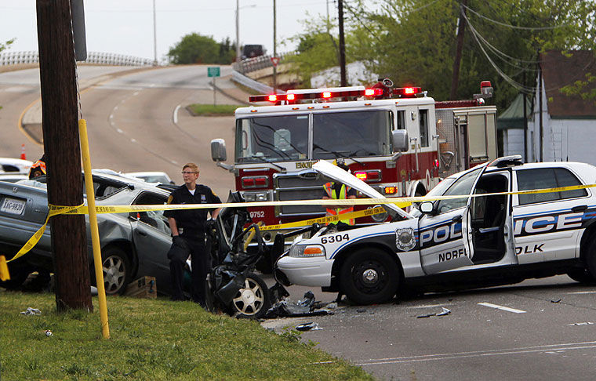
Problem to be solved
New Yorkers drivers spend 13% of their time sitting in congestion.
There are an estimated 6500 accident involving ambulance each year. 35% of crashes resulting in injury or fatality to at least 1 occupant of a vehicle involved.

Slide 3
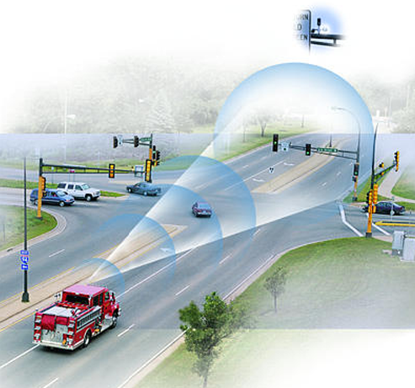
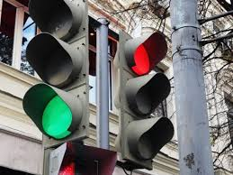
OBJECTIVES
Development of a smart traffic light system that allows to:
Reduce congestion by improving car circulation
Enable emergency vehicles to override traffic light conditions so that they can reduce arrival delays.

Slide 4
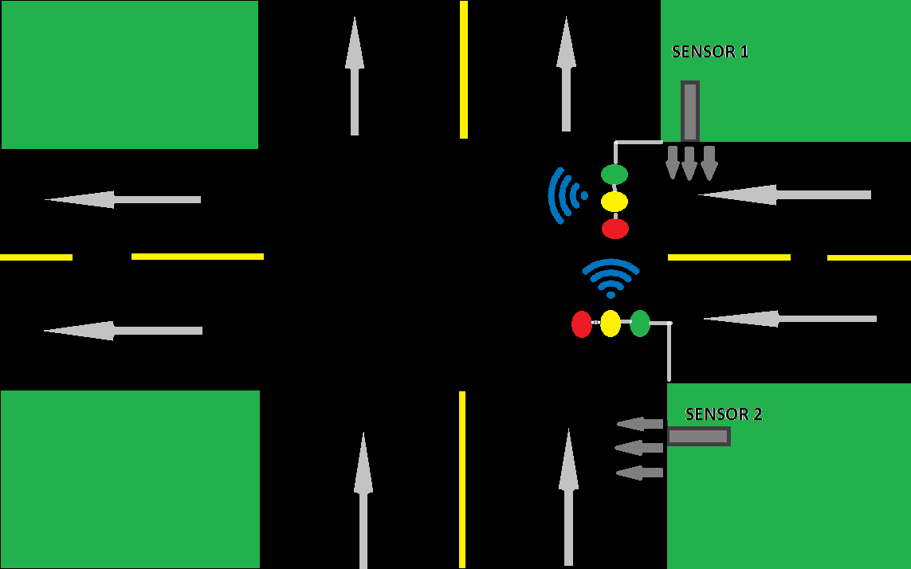
PROPOSED ARCHITECTURE

Slide 5
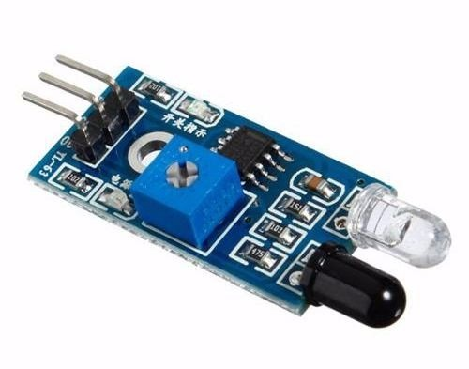
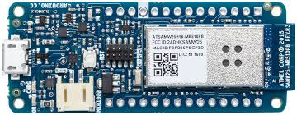
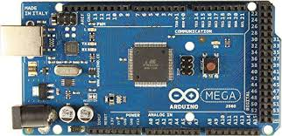
REQUIRED MATERIALS
2 IR Sensors
1 Arduino MKR 1000
1 Arduino MEGA 2560

Slide 6
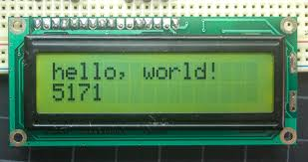
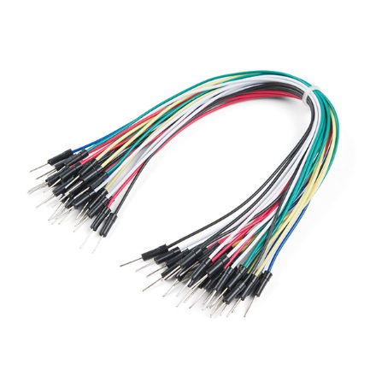
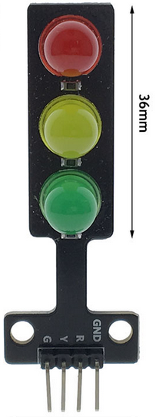

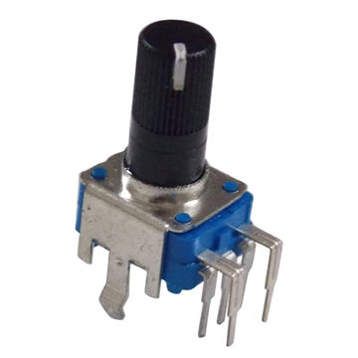
REQUIRED MATERIALS
LCD
Other Connectors

Slide 7
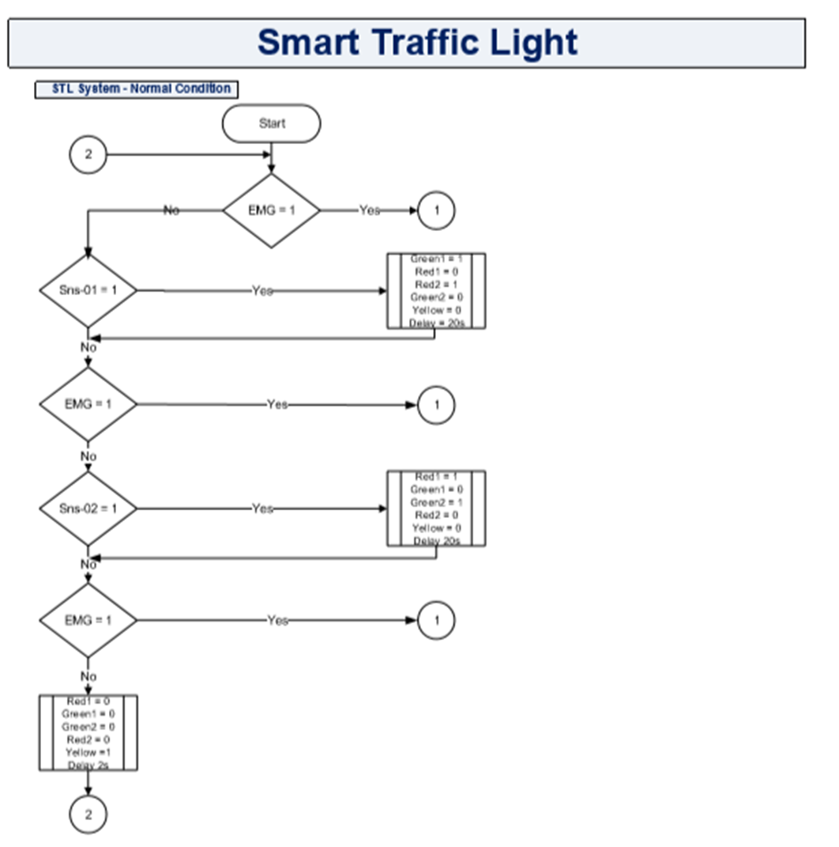
FLOWCHART

Slide 8
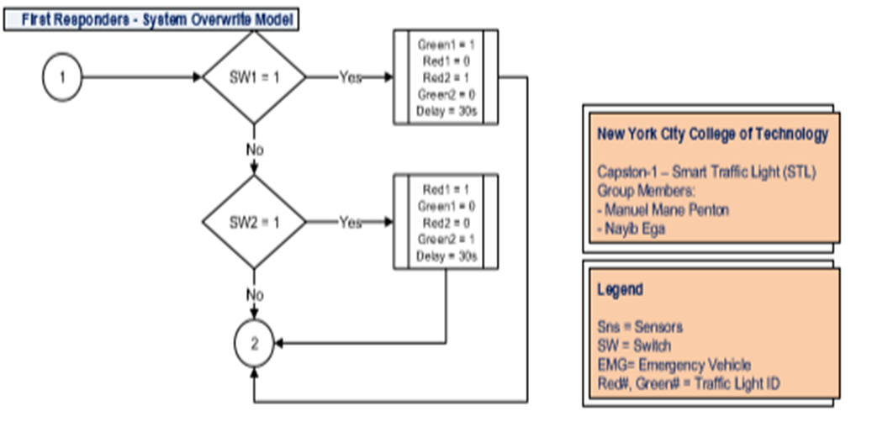
FLOWCHART

Slide 9
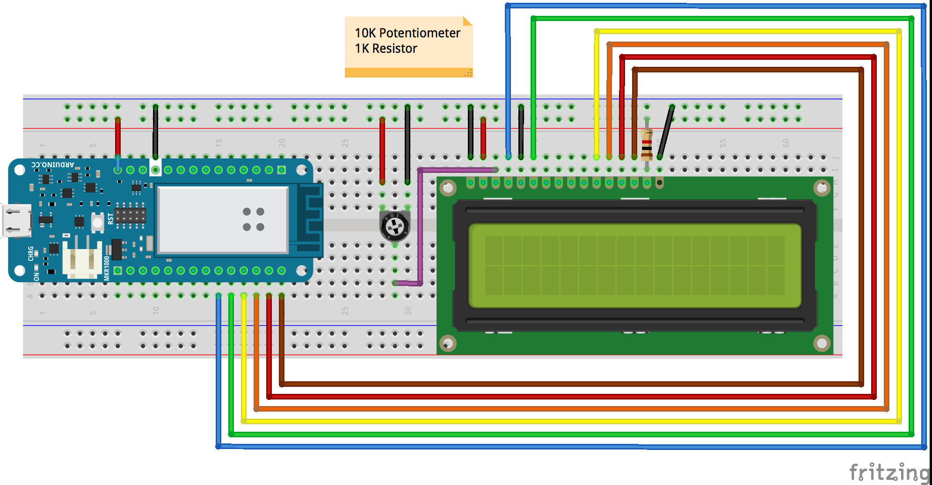
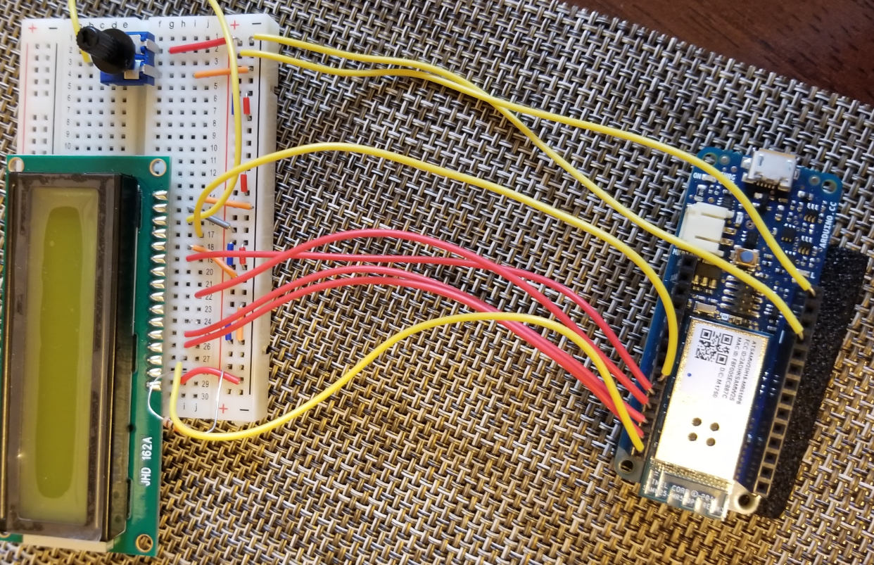
MKR100 – LCD Connection

Slide 10
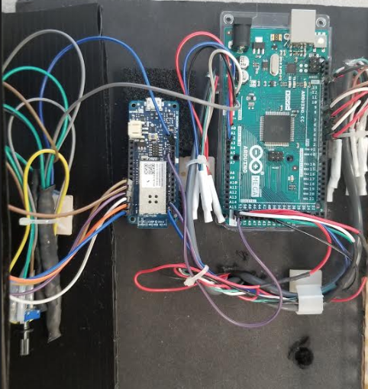
Arduino’s Connections

Slide 11
TRUTH TABLE

Slide 12
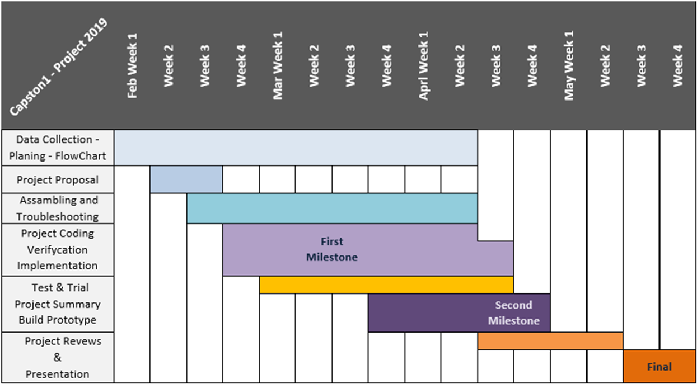
PROJECT TIMESHEET

Slide 13
PROJECT BUDGET

Slide 14
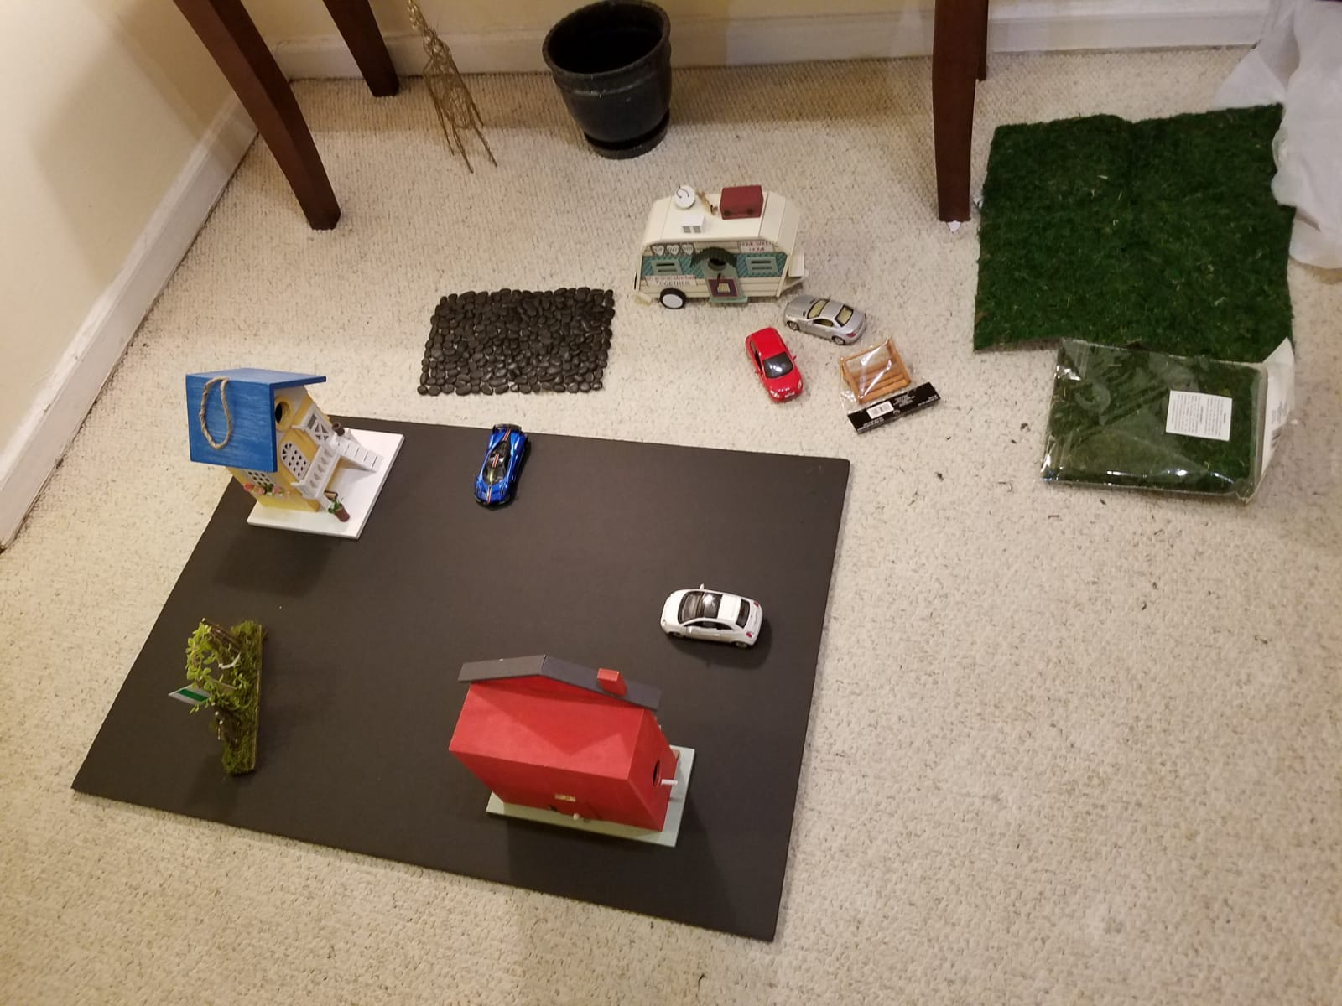
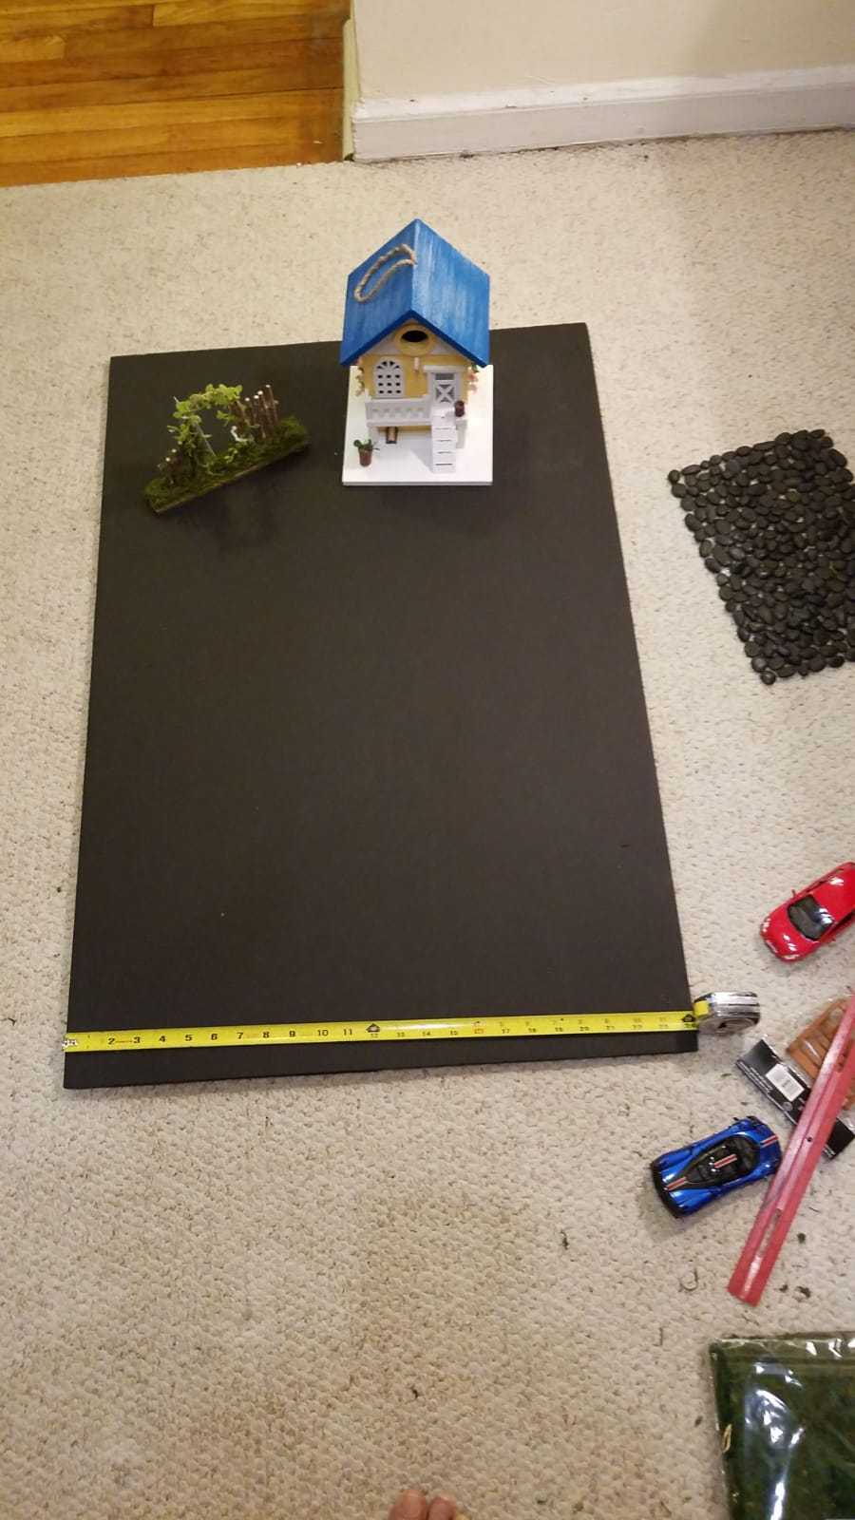
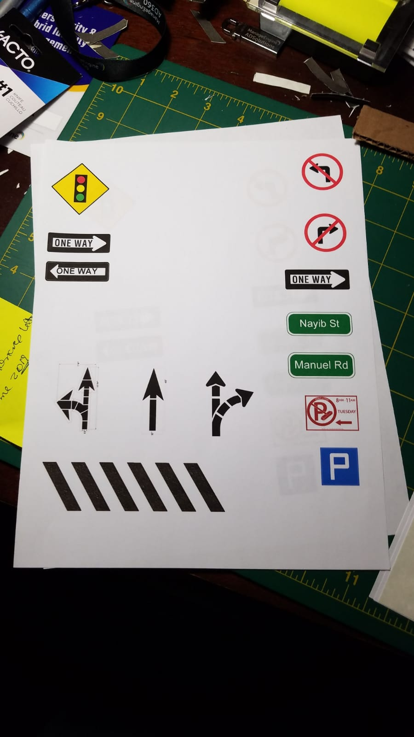
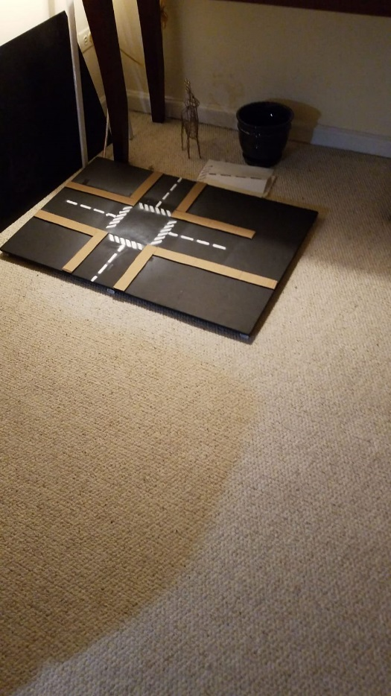
Board Progression

Slide 15
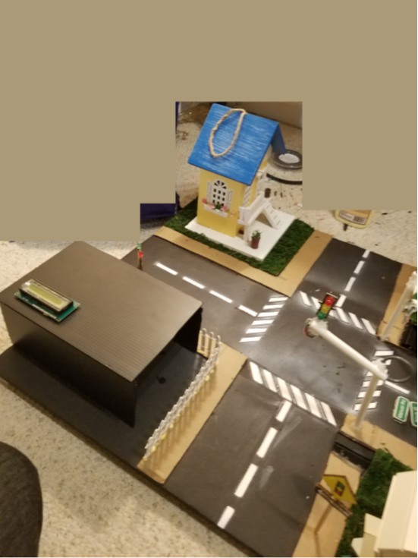
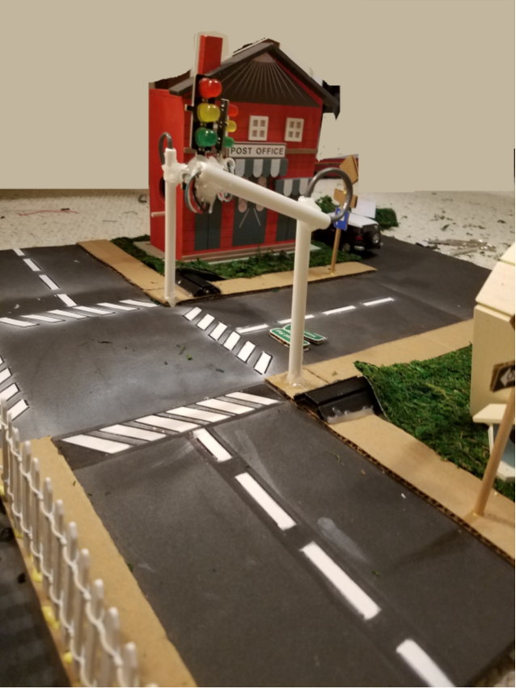
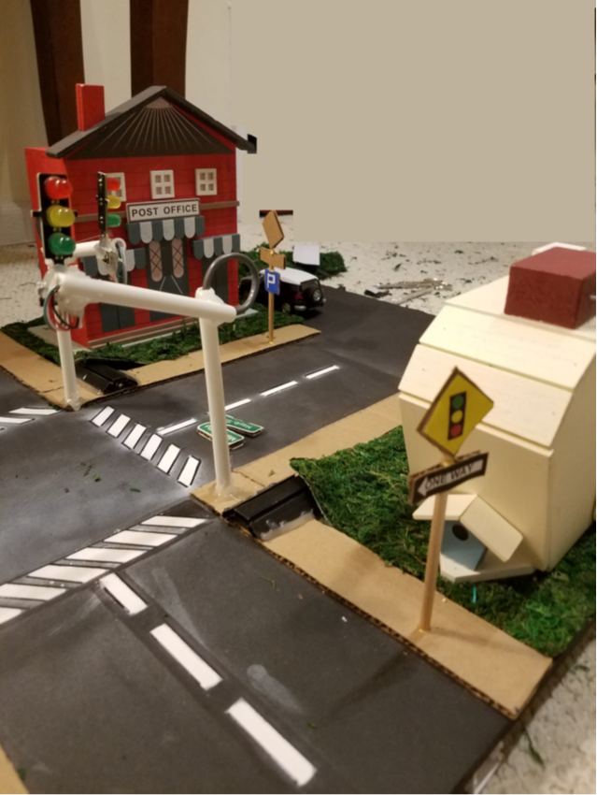

Slide 16

HERE CONCLUDES OUR
PROJECT. THANKS FOR
YOUR ATTENTION!!!

